Slide 1


R at AdRoll
Mark Hayden

Slide 2
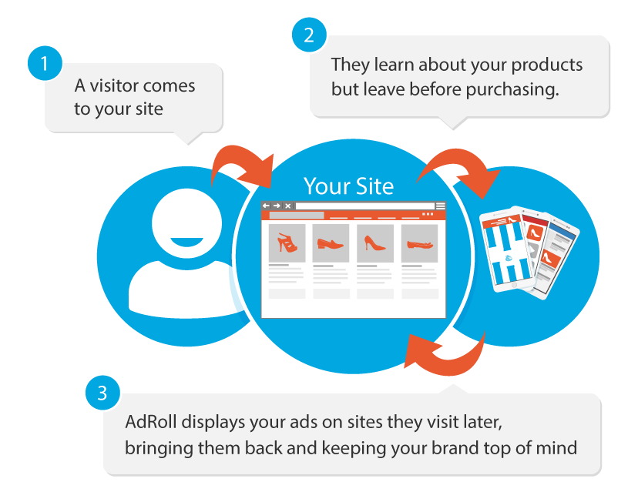
Retargeting

Slide 3
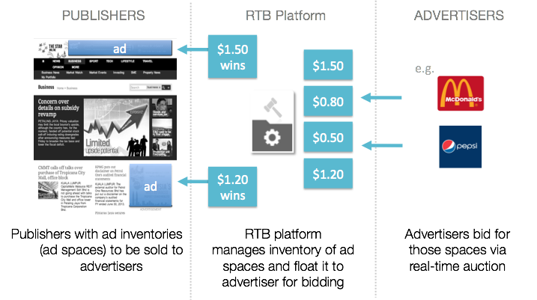
Real-time Bidding

Slide 4
Data Challenges
100+ TB/day on Amazon S3
100+ billion events/day
400+ million unique cookies/day
20K+ advertisers, 40M+ publisher domains
Logging constantly evolving
Heterogenous data sources
Hive
Postgres
MySQL
Kafka
Cassandra
Kinesis

Slide 5
Use Cases
Granular and real-time
Validate product logs to ensure features are working as intended
Analyze how changes to machine learning models affects RTB/Supply
Real-time monitoring of market trends and performance
Develop and monitor cookie level anti-fraud algorithms
Aggregated and fast
Standardize reporting and forecasting
Identify best practices for campaign set-up
Operational reporting for executives
Match product feature performance to customer segments to define go-to-market strategy

Slide 6
Presto, R, and Tableau
In-memory analytics

Slide 7
Presto https://prestodb.io/
What is it?
Distributed SQL Query Engine for Big Data
Can query and join data from S3, Postgres, etc..
Why do we like it?
Great for ad-hoc analytics
In-memory:10x faster than Hive/MapReduce
Flexible and linearly scalable on Amazon EC2
Easy to maintain and operate
Open source and under active development (used by FB, Airbnb, Dropbox, Netflix, and more)
Aggregation/ETL
Parsing and aggregating 40TB/100B rows to 5GB/250M rows ORCFile in <1 hour query (80 c3.4xlarge machines)
Sampling and distinct count approximation
Move tasks from ad-hoc to production in a couple of minutes

Slide 8
Presto Architecture
Raw Logs
CLI
Processed Logs
Presto Master
Presto Slaves
RPresto
BI Created ORCFile
Airpal
Postgres
Hive
Metastore
Postgres

Slide 9
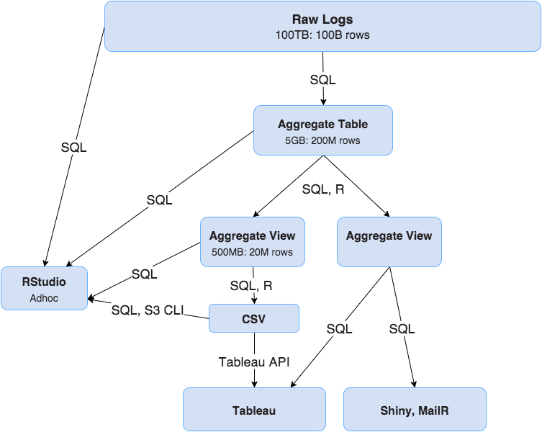
Analytics Pipeline

Slide 10
R
Why R?
Fast development speed
Easy to teach to someone who knows SQL
Flexible, versatile, and well-documented
Most things can be done in 244GB of memory
Ad-hoc Analysis
Cookie-level time series analysis
Fast visualizations
Raw log exploratory analysis for individual advertisers or publishers
Production Reporting
Data cleaning layer between Presto and Tableau
Forecasting
Fraud/outlier detection
Email reports
Turning ad-hoc analysis into recurring tasks without additional development

Slide 11
R
Environment
In-browser RStudio
Amazon r3.8xlarge EC2 machines (244 GB RAM)
Git for version control
Automation via jenkins (https://jenkins-ci.org/)
Packages
dplyr
data.table
RPresto
Rcpp
BH
ggplot2
shiny
mailR
knitR

Slide 12
RPresto
Raw SQL
rpresto_connection <- dbConnect(
RPresto::Presto(),
host='http://presto-dummyhost.com',
port=8080,
user='rpresto',
schema='bi',
catalog='hive'
)
dplyr integration
dplyr_connection <- src_presto(
host='http://presto-dummyhost.com',
port=8080,
user='dplyr',
schema='bi',
catalog='hive'
)

Slide 13
RPresto and dplyr
adcube <- tbl(dplyr_connection, 'adcube')
windows10_growth <- adcube %>%
filter(inventory_source == 'r' & date >= '2015-04-01') %>%
mutate(is_windows10 = (operating_system=='Windows 10')) %>%
group_by(date, is_windows10) %>%
summarize(impressions=sum(impressions)) %>%
collect()

Slide 14
RPresto and dplyr
adcube <- tbl(dplyr_connection, 'adcube')
windows10_growth <- adcube %>%
filter(inventory_source == 'r' & date >= '2015-04-01') %>%
mutate(is_windows10 = (operating_system=='Windows 10')) %>%
group_by(date, is_windows10) %>%
summarize(impressions=sum(impressions)) %>%
collect() %>% # Divide between what Presto does and what R does
group_by(date) %>%
mutate(perc_of_impressions = impressions/sum(impressions)) %>%
ggplot(aes(date, perc_of_impressions)) +
geom_area(aes(colour = is_windows10, fill= is_windows10), position = 'stack')

Slide 15
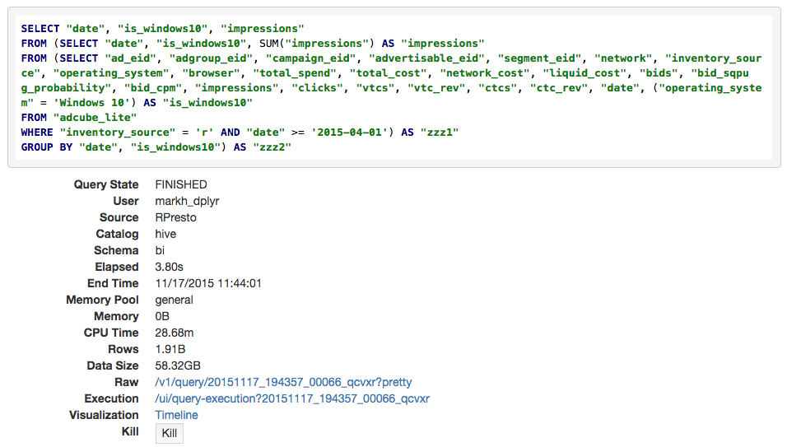
Query

Slide 16
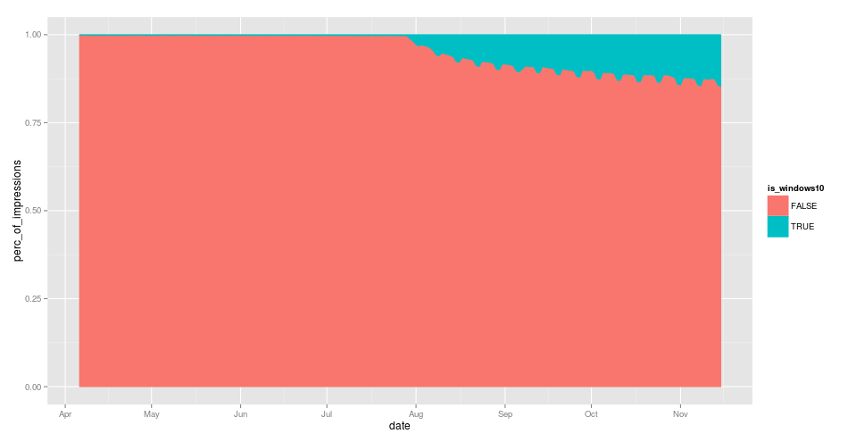
RPresto - output

Slide 17
Thank You
mark.hayden@adroll.com
(we’re hiring)

